Slide 1
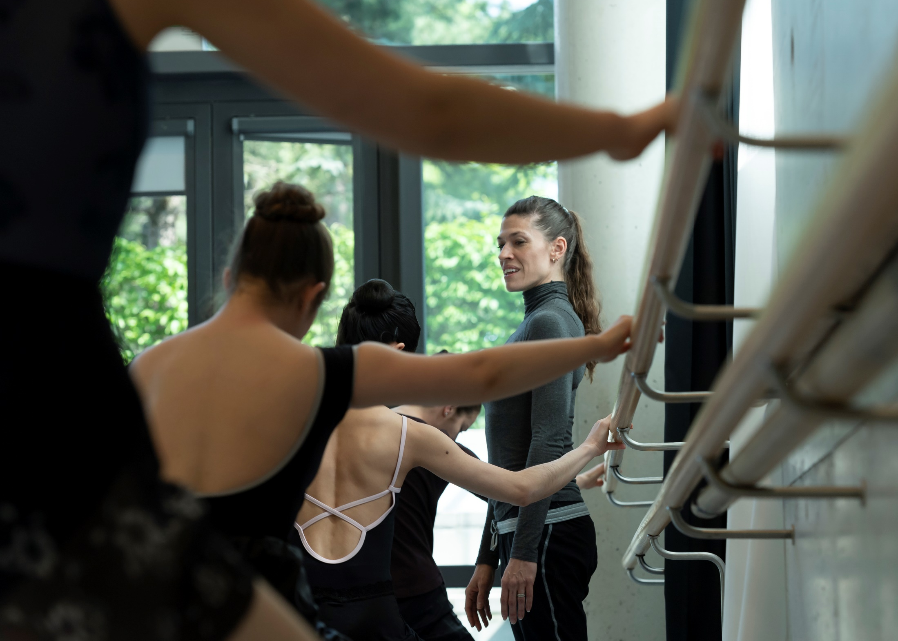
MA DANCE TEACHER PROGRAMME
Michael Rissmann | Interim Head of Programme
© Matthias Rietschel

Slide 2

MA DANCE TEACHER PROGRAMME
Master of Arts // 3-Year Programme (work-study)
Audience
Professional dancers and dance teachers who are working in professional training institutions, in the field pf community dance or in dance companies and theatres.
Programme Characteristics
Specialisation and Focus
Crosspollination between the MA Dance Teacher and BA Dance and MA Choreography Programme
interdisciplinary course and the subjects include dance, dance history, dance medicine, psychology, pedagogy and teaching practice, assistant teaching, composition and production/management.
Flexible module system
National & International Partnerships with a large artistic network.

Slide 3
FOCUS AND SPECIALISATION
Students may choose one focus and one specialisation
Focus:
Ballet or Contemporary/Modern Dance
Specialisation:
Ballet Master/Rehearsal Director
Requirements: Minimum 5 years of experience as a Dancer in a Company* or
verifiable experience as Ballet Master/Training Director/Rehearsal Director*
Dance Teacher for Professional Training
Requirements: 3 years of experience as a Dancer in a Company* or 5 years as a Dance Teacher*
Dance Teacher for Community Dance/Amateur fields
Requirements: Minimum 1 year of experience as a Dancer in a Company or minimum 3 years of experience as a Dance Teacher or successful completion of the aptitude test (video presentation of the stipulated variation/Etude)
*according to the chosen focus

Slide 4
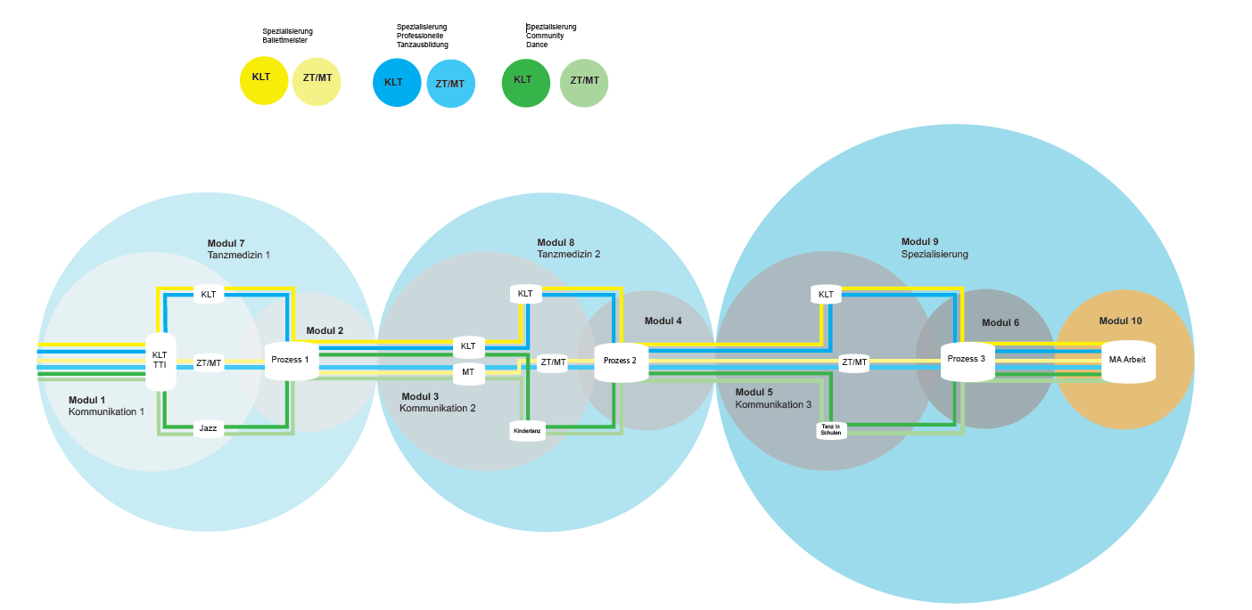
COURSE OF STUDY

Slide 5
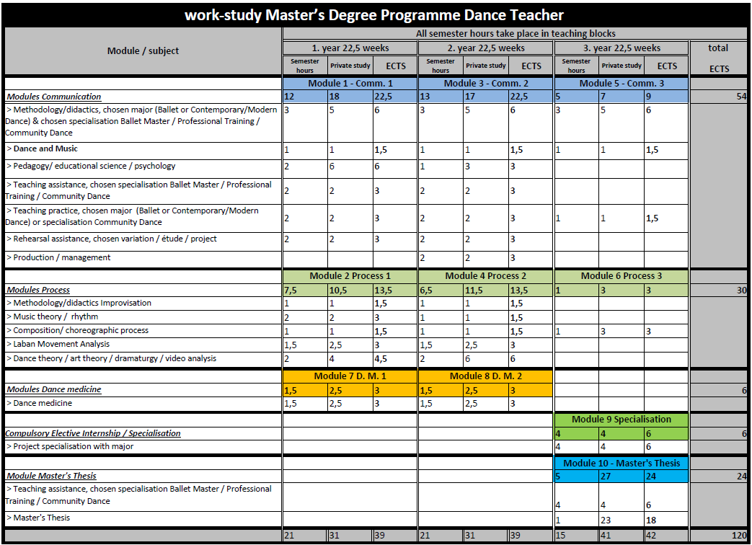
MODULES (work-study programme)

Slide 6
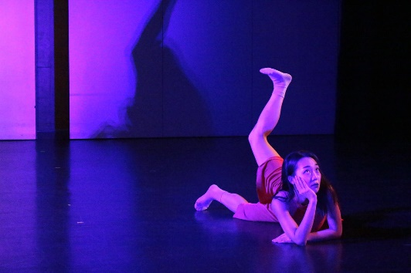
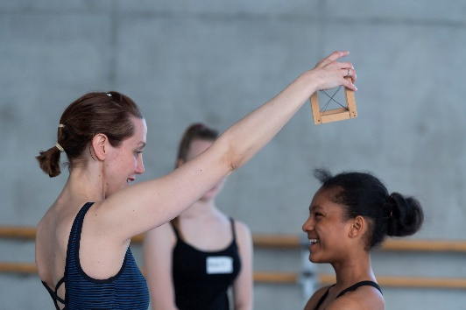
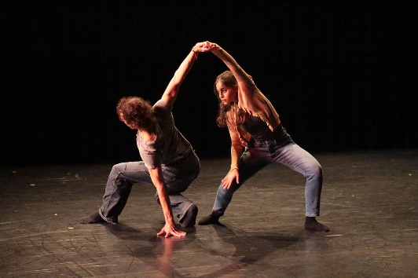
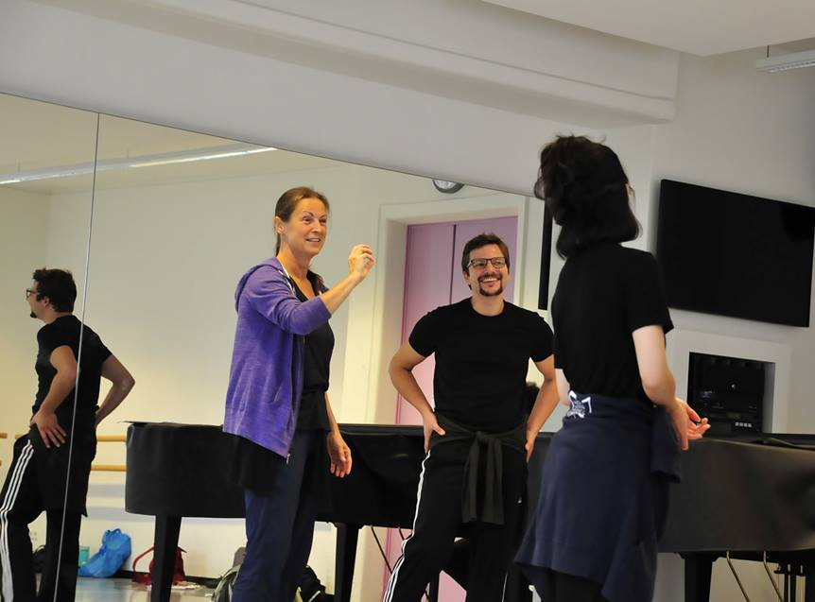
PREREQUISITES
General or subject-specific higher education entrance qualification or advanced technical college entrance qualification according to German law § 17 Abs. 2 SächsHSFG*
Teaching ability
C1 level English language (for the part-time work-study programme)
* Evidence of higher education or technical college in accordance with § 17 Abs. 11 SächsHSFG when especially high levels of artistic achievement can be provided.
© Christine Anna Schulze Beiering
© Matthias Rietschel
© Christine Anna Schulze Beiering
© Fernando Coelho

Slide 7
HOW TO APPLY (MADT)
Online Application (next enrolment MADT: Winter Semester 2025/26)
Application period 2025:
planned from 01.01.-14.03.25
Proof of C1 English level must be submitted by the end of 2nd semester
Fees and Tuition
Application fee: EUR 50 (one-time fee)
Semester fee: EUR 103.50 each semester
→ fee includes student community & student service, optional public transport for additional fees available
Tuition fee: EUR 750 each semester

Slide 8
APPLICATION DOCUMENTS
Tabular CV incl. detailed information on school education + work experience
Motivation letter according to Nr 1 b) admission regulation
Certified copy or official transcripts of school leaving certificate from secondary school (foreign degrees have to be handed in with a certified translation into German or English)
if applicable, certified copy of previous study periods (undergraduate and/or graduate studies) as well as study results and/or exam results
for work-study-programme: proof of English language Level C1
Other evidence of examination or qualification in the fields of art and pedagogy in accordance with § 2 para. 1
Proof of payment of application fee (copy of bank receipt)

Slide 9
ADMISSION AND ENROLMENT
Admission is a two-step process, consisting of a pre-selection (via application portal/online) and an online audition for MADT.
Pre-Selection (application portal)
  Evaluation of the dance and/or pedagogical qualifications based on the application documents for admission
Online Audition (dates are available on our website)
  Evaluation of the written concept for the practical training
  Implementation of the practical training as described in the concept of a group of dancers or of a single dancer (duration of 30 min.) by video link
  Interview with the Board of Admissions on line with the audition (no longer than 15 minutes)
Enrolment for MADT (work-study) takes place annually for the winter semester.

Slide 10
MASTER INFO DAY – MADT / MAC
MA Info Day 2025
Master Dance Teacher Program/Master Choreography Program
Online format
Registration and more information soon available on the Palucca homepage
Master Dance Teacher Program: 13.01.25, 19:00 – 20:30
Master Choreography Program: 20.01.25, 19:00 – 20:30

Slide 11
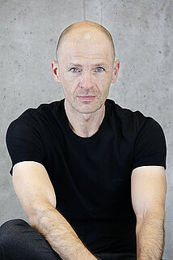


STAY IN TOUCH!
Interim Head of MA Dance Teacher Programme
Michael Rissmann
m.rissmann@palucca.eu
+49 (0)351 25906-58
© Ida Zenna
Homepage
https://palucca.eu/en/study-programmes/master-dance-teacher-programme
Notes:
72 hours before the set deadline of handing in the completed tasks, the candidate will receive all the tasks, 6 music files, a short dance video and the theme for the written reflection.

Slide 12
© Ida Zenna

